Slide 1
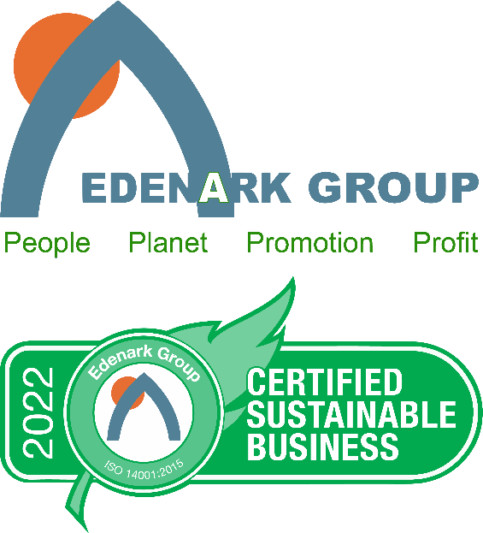
Doing the Right Thing can lead to a Good Thing!
Using Sustainability Certification to Differentiate

Slide 2
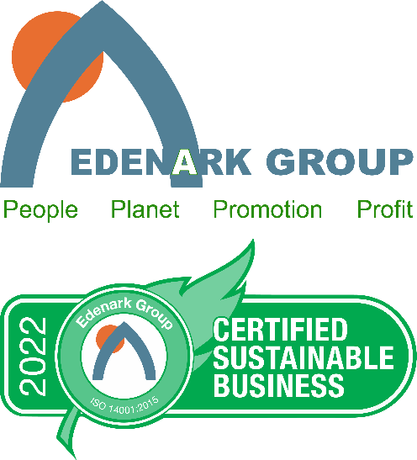
Let’s define Environmental Sustainability
“The ability to meet the needs of the present without compromising the ability of future generations to meet their own needs.” – The United Nations World Commission on Environment and Development
“The capacity to improve the quality of human life while living within the carrying capacity of the Earth’s supporting eco-systems.” – The International Union for Conservation of Nature

Slide 3
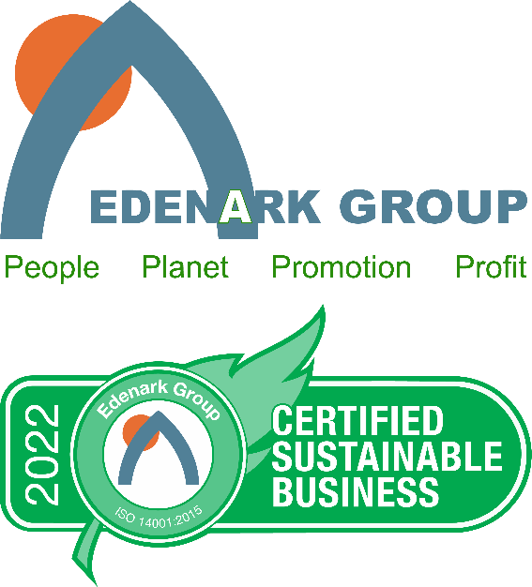
What is Our Definition of Corporate Environmental Sustainability?
“Maximize performance and return…without compromising the environment or future generations…via continual improvement of awareness, health, operation and efficiency of the organization…and promotion of sustainability certification and performance achievements and successes to all internal and external stakeholders.” – Edenark Group
Profit / Planet / People / Promotion

Slide 4
What are we going to talk about?
The four legs of the stool – sustainability certification / carbon neutrality / ESG / Net Zero
Why should you consider sustainability certification?
How do you pick a program?

Slide 5
Who is this talk for?
A SME (small to mid-sized enterprise)
Under 500 employees and/or US$1B in sales…at location
As examples, Chase is over $1B, but its branches are not; McDonald’s is over $1B but its restaurants are not. This is a business certification tied to physical location.
In EU/Asia, this would be 250 employees / US$100 million
99% of all global businesses
67% of global employment

Slide 6
The Four Legs of the Stool
Driven by consumer demand and government regulations, organizations will need to become certified sustainable; inclusive of a carbon neutrality plan and an ESG plan (and, ultimately, a Net Zero plan)
As example, in the US, HR1187 has passed the House and is sitting with the Senate – This will require public organizations, governments, AND THEIR SUPPLY CHAIN VENDORS, to become sustainable and have an ESG program
As example, the April 9 2021 US SEC Risk Alert suggests conforming to ‘global frameworks’ that follow UN Principles for Responsible Investing
Per industry experts, “This makes every non-ISO-based sustainability certification system obsolete.”

Slide 7
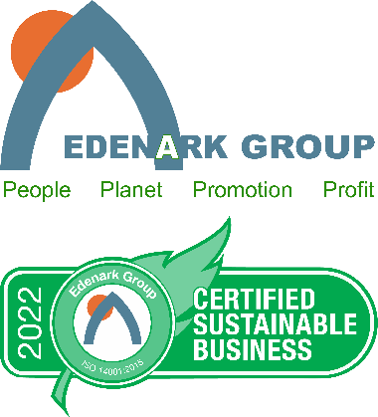
You Want a Complete, Legitimate Program
The ISO 14001 is the foundational standard used globally for data verification
The 14001 is bigger than all the other global standards added up and multiplied by 5
The UN and SEC use the ISO 14001
No other standard satisfies all four legs of the stool – With the 14001 as your foundational sustainability certification standard, you can build your carbon neutrality, ESG and Net Zero plans

Slide 8
You Want to Build Your Program Properly
Sustainability Certification comes first. It has the greatest ROI benefit for your company and, if you select the proper program, it will serve as the foundation for the other three, and training for your staff
Carbon Neutrality comes next – an easy addition to the sustainability certification foundation
ESG is third – this will add a degree of complexity, but with the right foundation, it is easy to add the S and G. If you start with ESG, it will be far harder for you and you will be under more scrutiny. Don’t start with ESG
Net Zero is last – this requires assistance from parties outside your company

Slide 9
The Edenark Group ISO 14001 Program
Top sustainability certification program for SMEs
Allows client to become certified sustainable and either simultaneously or later, build your carbon neutrality, ESG and Net Zero plans
Only program that focused on the revenue side of the P&L – superior ROI
Only program that also incorporates employee performance enhancement
Priced for SMEs

Slide 10
Why Should An Organization Become Certified Sustainable?
It is the right thing to do
Significant brand benefit
Your costs will go down
Your cost of money will go down
Consumers are demanding it
Government regulations will soon require it
Employee performance will improve
It is possibly the top competitive differentiation tool leading to significant sales gains
Certified sustainable companies are growing 75% - 20x faster than their non-certified peers

Slide 11
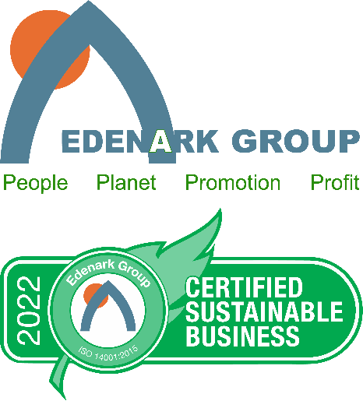
Let’s start with a question - What does a SME need most?
Per studies, the #1 thing ALL businesses (not just SMEs) need is competitive differentiation
ie, being seen as different/better than peers in a way that
motivates the customer to buy from you versus the other guy

Slide 12
Why is competitive differentiation harder for SMEs?
Large companies are marketing-centric
They have the $$$s to create branding
SMEs are more sales-centric
More dependent on face-to-face selling
More personal / direct

Slide 13
But what has the internet done?
The internet is a platform for consumers to review you without your active input
Go/no decisions are being made before you get a face-to-face
Covid has accelerated this

Slide 14
What is the #1 thing consumers are searching for?
Answer - Sustainability Certification
Per Google, corporate sustainability searches are up 800%
87% of consumers want your company to be sustainable
71% of consumers will move their business to a sustainable company
25% of consumers (the early adaptors) have already changed vendors due to sustainability. The next 25-35% (early majority) is happening now
Explosive interest in carbon neutrality, ESG and Net Zero
+$2 trillion in consumer spending LOOKING for sustainable companies

Slide 15
Why not hang a “We are sustainable!” sign?
It would do more harm than good
+70% of consumers disbelieve a company that makes claims that are not verified/certified by a legitimate 3rd party
+70% of consumers believe a company that makes claims that are verified/certified by legitimate 3rd party

Slide 16
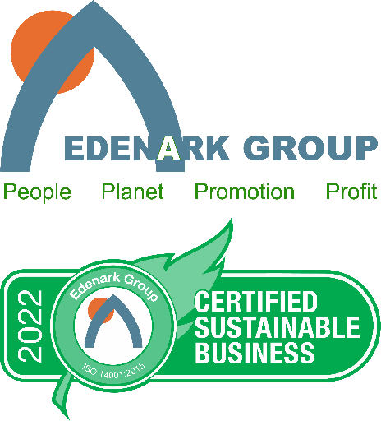
How are ‘certified’ sustainable companies performing v non-certified peers?
Companies that are certified sustainable via a globally-recognized standard, and promote same…compared to their non-certified competitive peers
+75% overall growth (NY/Stern says 7x / Symbola says 20x)
+67% investor ROI
+24% Net Income
+15% sales gains
+11% EBITDA

Slide 17
So is Sustainability Certification Worth Considering?
Yes!
9 out of 10 consumers want you to be certified sustainable
7 of 10 consumers will move their business
Significant low hanging fruit
Most big companies are already promoting their sustainability
New concept for SMEs
Bigger opportunity for an SME to stand out
Results are compelling
You get rewarded for doing a good thing

Slide 18
What now?
If corporate environmental sustainability is worth considering, where do we start and what do we do?

Slide 19
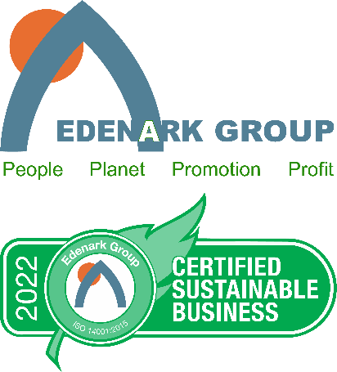
Let’s first revisit certification
“Why do we need a certification at all? Why can’t we just pursue sustainability internally?”
If you know what to do and do everything right….
You will help the environment
You will not maximize brand image, revenues or profits
You will not lead others, as there is nothing to replicate

Slide 20
To Maximize Benefit of Corporate Environmental Sustainability
Find a program that offers these 8 components
Employee performance / health enhancement
Certify the business not the box
3rd party audit
Use global standard
Promotion of the certification
Continual improvement
Annual update
Price

Slide 21
Employee Performance / Health Enhancement
Sustainability is not just about energy savings or ‘Greening Up’, it is about people
For most businesses, the employees are one of the biggest costs, one of the biggest risks (mistakes, insurance, law suits) and one of the biggest opportunities (new ideas, collaboration, product knowledge)
Every organization suffers from the Big 5 – insomnia, stress, anxiety, physical pain, mental acuity
You are losing 5% of your corporate profit/year to the Big 5
It takes a lot of LEDs to make up for one worker comp or workplace violence case
Make sure your program has a ‘people piece’ that addresses employee performance, health and happiness

Slide 22
Certify the Business not the Box
People care about things that involve people
Most building (ie, ‘Box’) certifications, like LEED, only care about building energy
Building certifications are expensive and hard to market (poor ROI)
You want to say, “Buy more of my product because we are a certified sustainable business”
You do not get much value from, “Buy more of my product because we are in an energy efficient building”
You want the certification on your business, not the building your business is in

Slide 23
3rd Party Audit
Oversight delivers credibility and trust
From passing your driving test, to getting your college diploma, to passing a bar exam, we use 3rd parties to ensure compliance
There are many sustainability programs that deliver a certification based on your ‘word’…..and your payment
Don’t do it!
Make sure the program you choose uses a 3rd party to validate your work

Slide 24
Use a Respected and Integrated Global Standard
The sustainability industry is maturing and coalescing around the ISO 14001
The UN has created its SDGs (17 sustainability development goals)
The EU is starting to tie lending to sustainability
The SEC is starting to look at sustainability, carbon neutrality and ESG (Environment, Social, Governance) claims
Don’t pick a program that is not globally respected by, and integrated with, the world leadership groups; and that does not have the ability to integrate sustainability, carbon neutrality and ESG
No reason to spend the time and money, then find you are not following the same programs and protocols that the leadership groups have adopted

Slide 25
Promotion of the Certification
Historically, sustainability has been a cost-side play
Most programs and providers have been 100% trained and focused on cost-side measures – energy reduction, carbon reduction, waste reduction, water reduction, travel reduction (ie, engineering)
But we know consumers are searching for certified sustainable companies
If you don’t talk about being certified sustainable they will never know you are (ie, marketing)
You want a program provider that is built to do the cost-side work AND the revenue-side work; and helps you promote your certification

Slide 26
Continual Improvement
Sustainability is not finite. It requires long-term commitment
But…..change is hard for all of us
If the bar is set too high, we can get frustrated and give up
You want a program that lets you come as you are
Allows you to proceed at a pace that suits your organization
Focuses on fun for staff
Success is based on continual improvement

Slide 27
Annual Update
Current = credible
Sustainability is not finite; we need to continually improve
You don’t want a program that does not have a date attached to its certification
You want to continually improve, see your success, and annually update your certification to show you are current and credible in your actions

Slide 28
Cost
We could have started with cost, but you want the above 7 components at a price you can afford
Our cost, designed for SMEs, is roughly 5-10% of other programs – we deliver the top program in the world at a fraction of the historical cost
Cost includes
The certification
Improvements to qualify for the certification (client may choose to do more)
The 3rd party audit

Slide 29
Your Biggest Fears
Change
Getting up to speed (confident enough to make a decision)
Staff time

Slide 30
Good News!
Our program meets all 8 of the criteria (including being affordable!)
The review process is easy and painless
Changes can be modest and gradual
Staff involvement can be minimal
It can be fun and very beneficial
If done right, promotion can get in front of certification (ie, you can promote the pursuit of the certification which helps with differentiation and getting revenues ahead of costs)
We are happy to help

Slide 31
Edenark Group
www.edenark.com
David Goodman
+1-844-722-3937
dgoodman@edenark.com

